Slide 1
MODULE 4
Hemavathy S

Slide 2

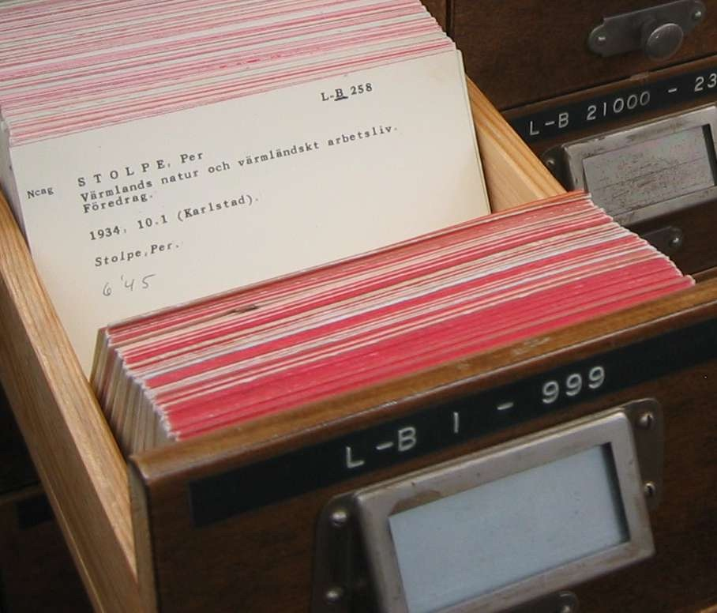
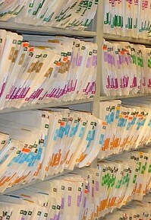
A Story of Two Collections..
List
A linear collection of values Lookup by position 0 .. length-1
Dictionary
A linear collection of key-value pairs Lookup by "tag" or "key"

Slide 3
Dictionaries
Dictionaries are Python’s most powerful data collection
Dictionaries allow us to do fast database-like operations in Python
Similar concepts in different programming languages
- Associative Arrays - Perl / PHP
- Properties or Map or HashMap - Java
- Property Bag - C# / .Net

Slide 4
dictionary
Dictionary in Python is an ordered collection of data values
A Dictionary holds a key: value pair. Key-value is provided in the dictionary to make it more optimized.

Slide 5
Dictionaries over time in Python
Prior to Python 3.7 dictionaries did not keep entries in the order of insertion
Python 3.7 (2018) and later dictionaries keep entries in the order they were inserted
“Insertion order" is not "always sorted order"

Slide 6
Creating a Dictionary
1. Creating an EMPTY dictionary TWO ways
dictname = {}
dictname = dict()
Example:
Dict1 = {}
MyDict = dict()
Books = {}

Slide 7
Creating a Dictionary
2. Creating a dictionary with items individually
Dictname[key1] = val1
Dictname[key2] = val2
Example
MyDict = {}
MyDict[1] = ‘Chocolate’
MyDict[2] = ‘Ice cream’
print(MyDict)

Slide 8
Creating a Dictionary
3. Creating a dictionary with items
dictname = {key1:val1, key2:val2, ….}
Example:
MyDict = { 1 : ‘Chocolate’, 2 : ‘Icecream’}
MyCourse = {‘MS’ : ‘Python’, ‘IT’ : ‘C’, ‘CSE’ : ‘C++’, ‘MCA’ : ‘Java’}
MyCircle = {‘Dad’:9486028245,‘Mom’:9486301601}

Slide 9
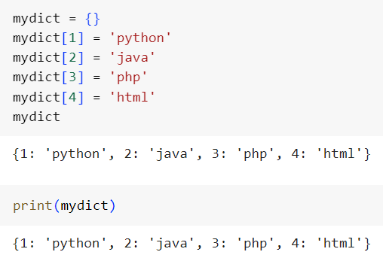

Slide 10
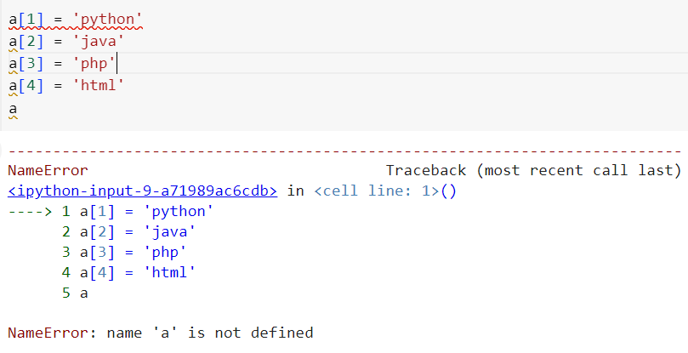

Slide 11
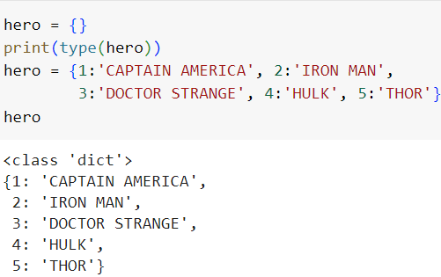

Slide 12
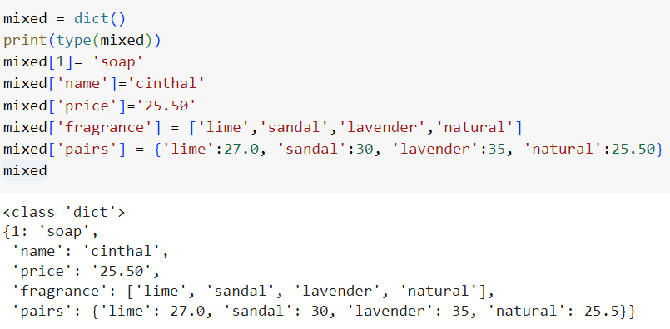
Try using print(mixed) instead of just mixed

Slide 13
Accessing Values
MyDict = { 1 : ‘Chocolate’, 2 : ‘Icecream’}
MyCourse = {‘MS’ : ‘Python’, ‘IT’ : ‘C’,‘CSE’ : ‘C++’, ‘MCA’ : ‘Java’}
Using keys within square brackets
>>> print (MyDict[1])
‘Chocolate’
>>> print (MyCourse[‘CSE’])
‘C++’

Slide 14
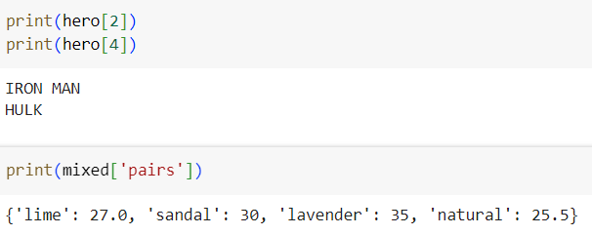

Slide 15
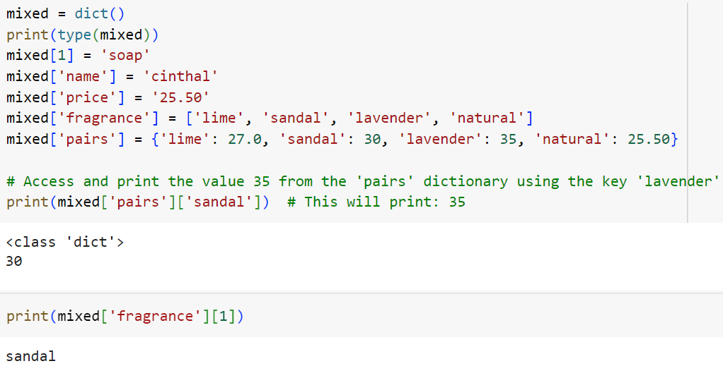

Slide 16
Updating Elements
MyDict = { 1 : ‘Chocolate’, 2 : ‘Icecream’}
MyCourse = {‘MS’ : ‘Python’, ‘IT’ : ‘C’,‘CSE’ : ‘C++’, ‘MCA’ : ‘Java’}
>>>MyDict[1] = ‘Pizza’
>>>MyCourse[‘MCA’] = ‘UML’
>>>print(MyDict)
>>>print(MyCourse)
Output
{1: 'Pizza', 2: 'Icecream'}
{'MS': 'Python', 'IT': 'C', 'CSE': 'C++', 'MCA': 'UML'}

Slide 17
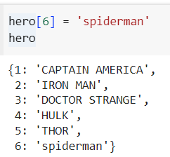

Slide 18
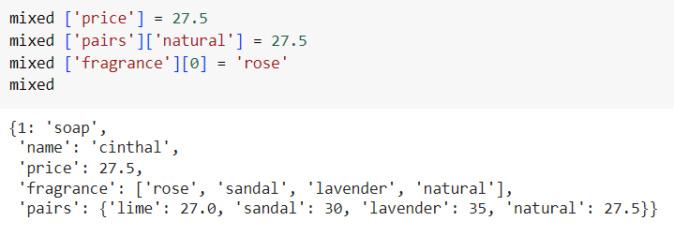

Slide 19
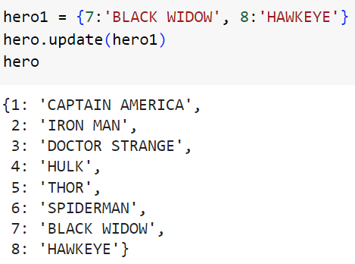
Using Update method
.Update() method

Slide 20
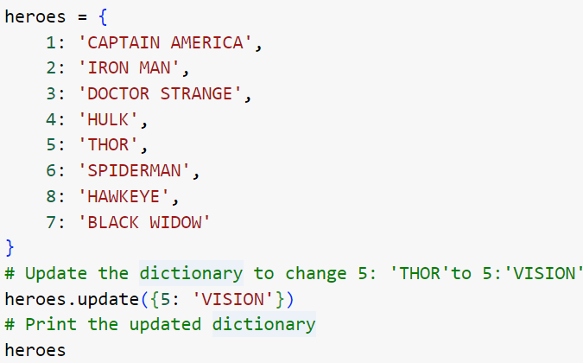
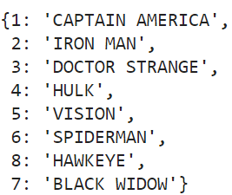
OUTPUT

Slide 21
Deleting Elements
remove an element in a dictionary using the key
>>>del MyCourse[‘IT’]
remove all the elements
>>>MyCourse.clear()
delete the dictionary
>>>del MyCourse

Slide 22
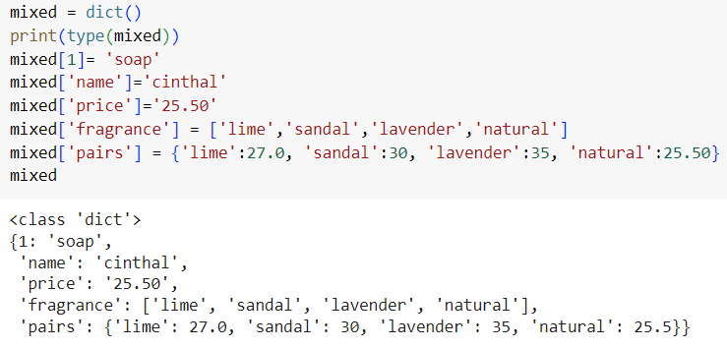

Slide 23
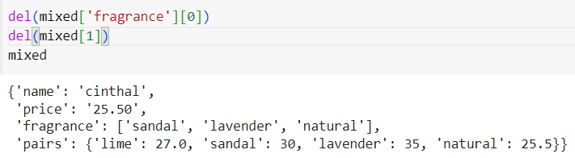

Slide 24
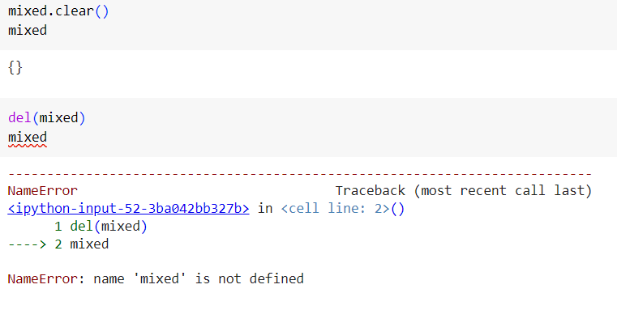

Slide 25
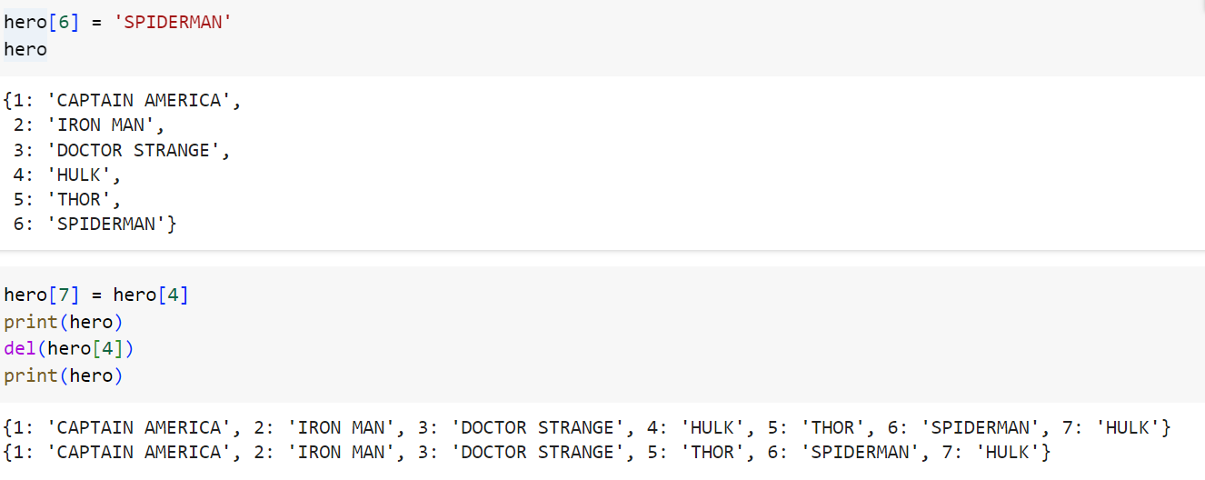

Slide 26

Using POP method
.pop() method
>>> hero.pop(7)

Slide 27
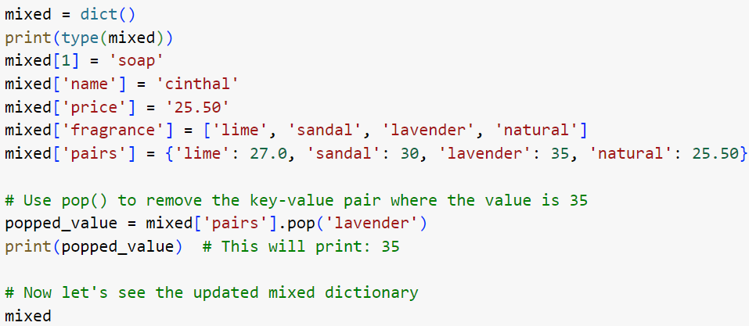
Using POP method
.pop() method

Slide 28
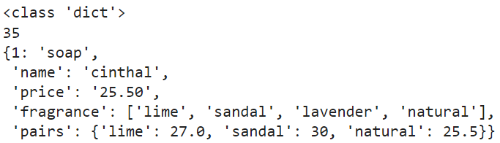
OUTPUT

Slide 29
Basic Operations
1. Length of the dictionary
>>> len(D)
Gives the length of the keys. That is the number of keys present

Slide 30
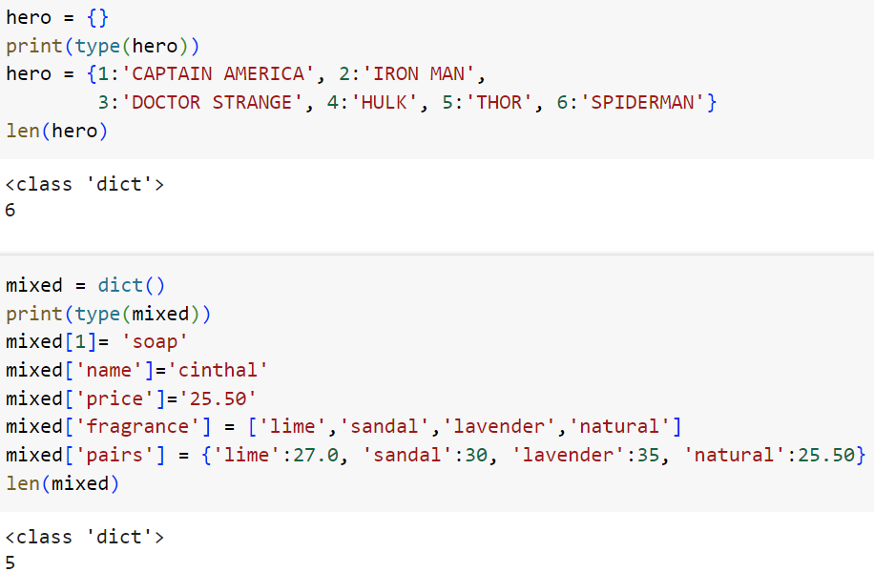
Basic Operations

Slide 31
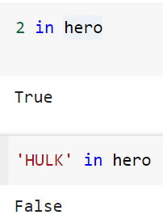
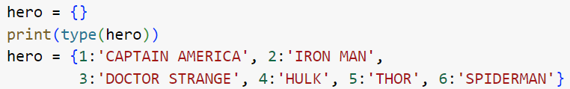
Basic Operations
2. Membership operator
>>> 2 in hero

Slide 32
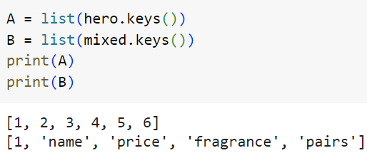
Basic Operations
3. Create a new list of the dictionary’s keys
>>> list(hero.keys()) >>> list(mixed.keys())

Slide 33
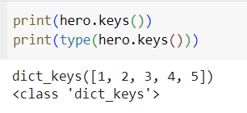
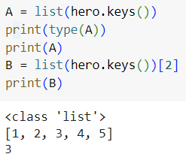

Slide 34
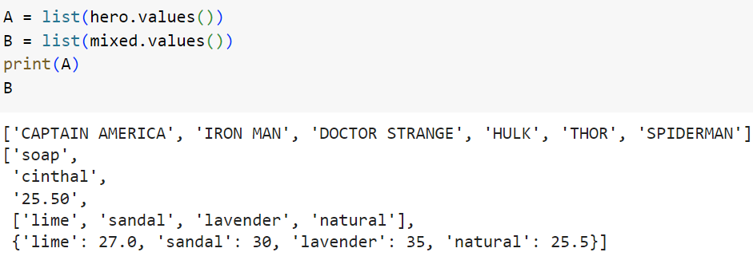
Basic Operations
4. Create a new list of the dictionary’s values
>>> list(hero.values()) >>> list(mixed.values())

Slide 35
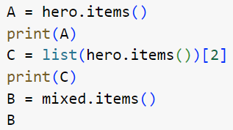
Basic Operations
5. Create a new list of the dictionary’s items
>>> list(hero.items()) >>> list(mixed.items())

Slide 36
OUTPUT
dict_items([(1, 'CAPTAIN AMERICA'), (2, 'IRON MAN'), (3, 'DOCTOR STRANGE'), (4, 'HULK'), (5, 'THOR'), (6, 'SPIDERMAN')])
(3, 'DOCTOR STRANGE’)
dict_items([(1, 'soap'), ('name', 'cinthal'), ('price', '25.50'), ('fragrance', ['lime', 'sandal', 'lavender', 'natural']), ('pairs', {'lime': 27.0, 'sandal': 30, 'lavender': 35, 'natural': 25.5})])

Slide 37
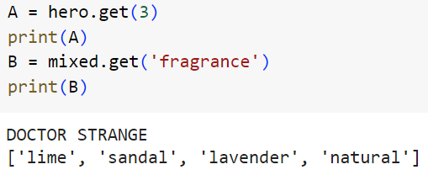
Basic Operations
6. To get a value from the key using get method
>>> hero.get(3) >>> print(mixed.get(‘fragrance’))

Slide 38
Nesting in dictionaries
jobs = []
jobs.append('developer')
jobs.append(‘manager‘)
rec = {}
rec['name'] = 'Bob'
rec['age'] = 40.5
rec['job'] = jobs

Slide 39
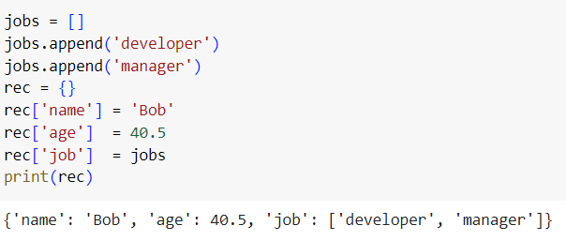

Slide 40
Comprehensions in Dictionaries
1. D = {k: v for (k, v) in zip(['a', 'b', 'c'], [1, 2, 3])}
print(D)
>>{'a’: 1, 'b': 2, 'c': 3}
2. D = {x: x ** 2 for x in [1, 2, 3, 4]} # Or: range(1, 5)
>> {1: 1, 2: 4, 3: 9, 4: 16}

Slide 41
Comprehensions in Dictionaries
3. D = {c: c * 4 for c in 'SPAM'}
print(D)
>>{'S': 'SSSS', 'P': 'PPPP', 'A': 'AAAA', 'M': 'MMMM'}

Slide 42
Comprehensions in Dictionaries
4. D = {c.lower(): c + '!' for c in ['SPAM', 'EGGS', 'HAM']}
print(D)
>>{'spam': 'SPAM!', 'eggs': 'EGGS!', 'ham': 'HAM!'}

Slide 43
